Slide 1
PROTOTYPING
Prototyping is the activity of creating incomplete versions of the product being developed.

Slide 2
PROTOTYPING MODEL
It is one of the forms of the Software Development Cycle (SDLC) models, which is based on the quick initial development of the prototypes based on the currently available or limited requirements
In this model, a prototype of the end product is first developed, tested and refined as per customer feedback repeatedly till a final acceptable prototype is achieved.

Slide 3
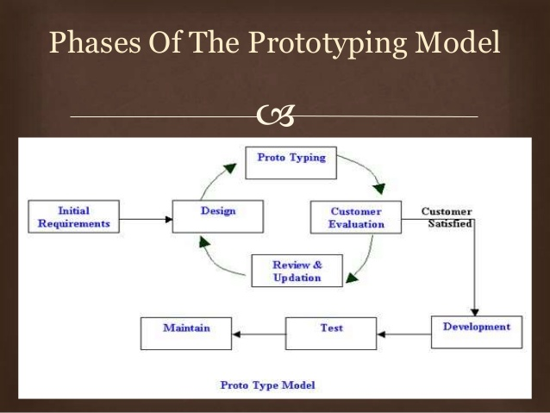

Slide 4
WHEN????
When the desired system needs to have a lot of interaction with the end users
System which needs high amount of interaction with end users like online systems, web interfaces are best suited for Prototype model.

Slide 5
1. A film (movie) prototype
Here a prototype is made using video just to show others the idea in a graphical/visual format.
2. Feasibility Prototype
It is applied to the resolve technical risks attached to the development in terms of performance, compatibility of components etc.
3. Horizontal Prototype
This is the user interface in the form of screenshots, demonstrating the outer layer of the human interface only, such as windows, menus, and screens. The prototype is used to clarify the scope and requirements of the product.
4. Rapid Prototype
The rapid prototyping technique is used to quickly engineer an initial model of a product using a three-dimensional computer-aided design when you want to produce something in a short span.
5. Simulations
Simulation prototype is digitally creating of a physical product to predict the performance of the
product in the real world.

Slide 6
ADVANTAGES
Increased user involvement in the product even before its implementation.
Since a working model of the system is displayed, the users get a better understanding of the system being developed.
Reduces time and cost as the defects can be detected much earlier.
Quicker user feedback is available leading to better solutions.
Missing functionality can be identified easily.
Confusing or difficult functions can be identified.

Slide 7
DISADVANTAGES
Risk of insufficient requirement analysis owing to too much dependency on the prototype.
Users may get confused in the prototypes and actual systems.
Practically, this methodology may increase the complexity of the system as scope of the system may expand beyond original plans.
Developers may try to reuse the existing prototypes to build the actual system, even when it is not technically feasible.
The effort invested in building prototypes may be too much if it is not monitored properly.

Slide 8
OBJECT ORIENTED MODEL
This software life cycle is typically divided up into stages going from abstract descriptions of the problem to designs then to code and testing and finally to deployment.

Slide 9
OBJECT ORIENTED PROGRAMMING
Object-oriented programming (OOP) is a software programming model constructed around objects. This model compartmentalizes data into objects (data fields) and describes object contents and behavior through the declaration of classes (methods)

Slide 10
OBJECT ORIENTED MODEL
Software design model which uses object oriented programming
Main goal of the OOM is the increasing the reusability capacity of the software, reducing the complexity and the software systems maintenance costs
based on the classes which identify the behavior of the data present in the software system
describes a set of analysis, design and implementation processes and this has made the development of the most of the software systems on the bases of object oriented.

Slide 11
One of the main goals is emphasizing the reduction of costs and the time for production of software
uses the classes and this presents an efficient method for integration in development of software

Slide 12
OBJECT ORIENTED ANALYSIS(OOA)
identifies the software requirements in software development activities
fulfills and executes the main requirements of the users, studies the feasibilities, validates the specifications and manages the requirements

Slide 13
OBJECT ORIENTED DESIGN(OOD)
OOD is focused on organizing the objects in the classes and all methods and the functions in a class are defined in OOD stage
OOD is a process in which the user requirements are transformed to a design for software creation
OOD transforms the data objects defined in analysis model to the data classes which conform to software development

Slide 14
PROS
Reduced Maintenance
Real-World Modeling
Improved Reliability and Flexibility
Reusability
Focuses on data rather than the procedures as in Structured Analysis

Slide 15
CONS
Object-oriented Development is not a panacea
The object-oriented models do not easily show the communications between the objects in the system
All the interfaces between the objects cannot be represented in a single diagram

Slide 16
AGILE MODEL
Agile SDLC model is a combination of iterative and incremental process models with focus on process adaptability and customer satisfaction by rapid delivery of working software product.

Slide 17
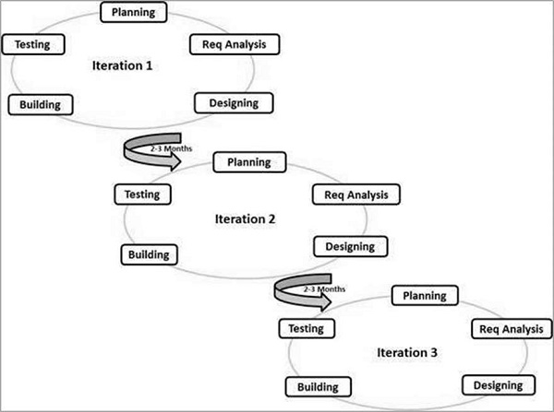

Slide 18
PRINCIPLES
Individuals and Interactions
Working software
Customer collaboration
Responding to change

Slide 19
PROS
Customer satisfaction through early and continuous software delivery
Accommodate changing requirements throughout the development process
Frequent delivery of working software
Collaboration between the business stakeholders and developers throughout the project
Agile processes to support a consistent development pace
Simplicity
Regular reflections on how to become more effective

Slide 20
CONS
Agile may not work as expected, for example, if a client is not clear about the goals, if the project manager or the team has no experience or if they do not “work well” under pressure.
Because the Agile methodology has less formal and more flexible processes, it may not always be easily included into larger and more traditional organizations.
Furthermore, given that this methodology focuses mainly on the short term, the risk that the long-term vision will be lost

Slide 21
EXTREME PROGRAMMING
Extreme Programming (XP) is an agile software development framework that aims to produce higher quality software, and higher quality of life for the development team.

Slide 22
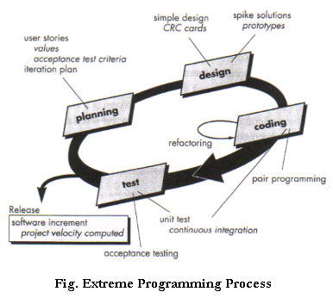

Slide 23
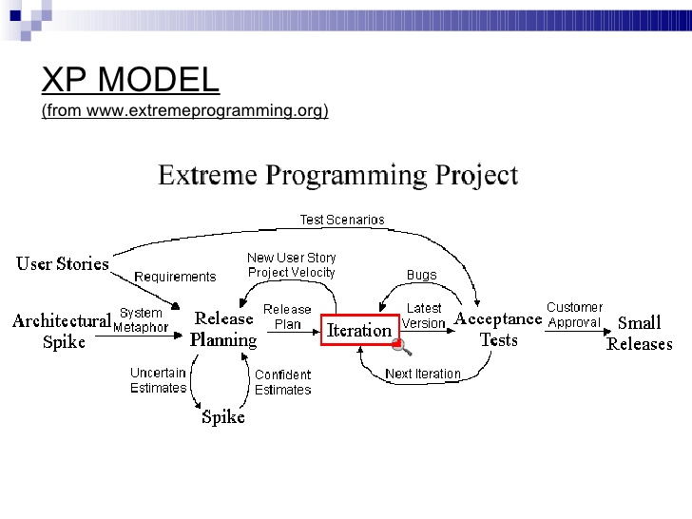

Slide 24
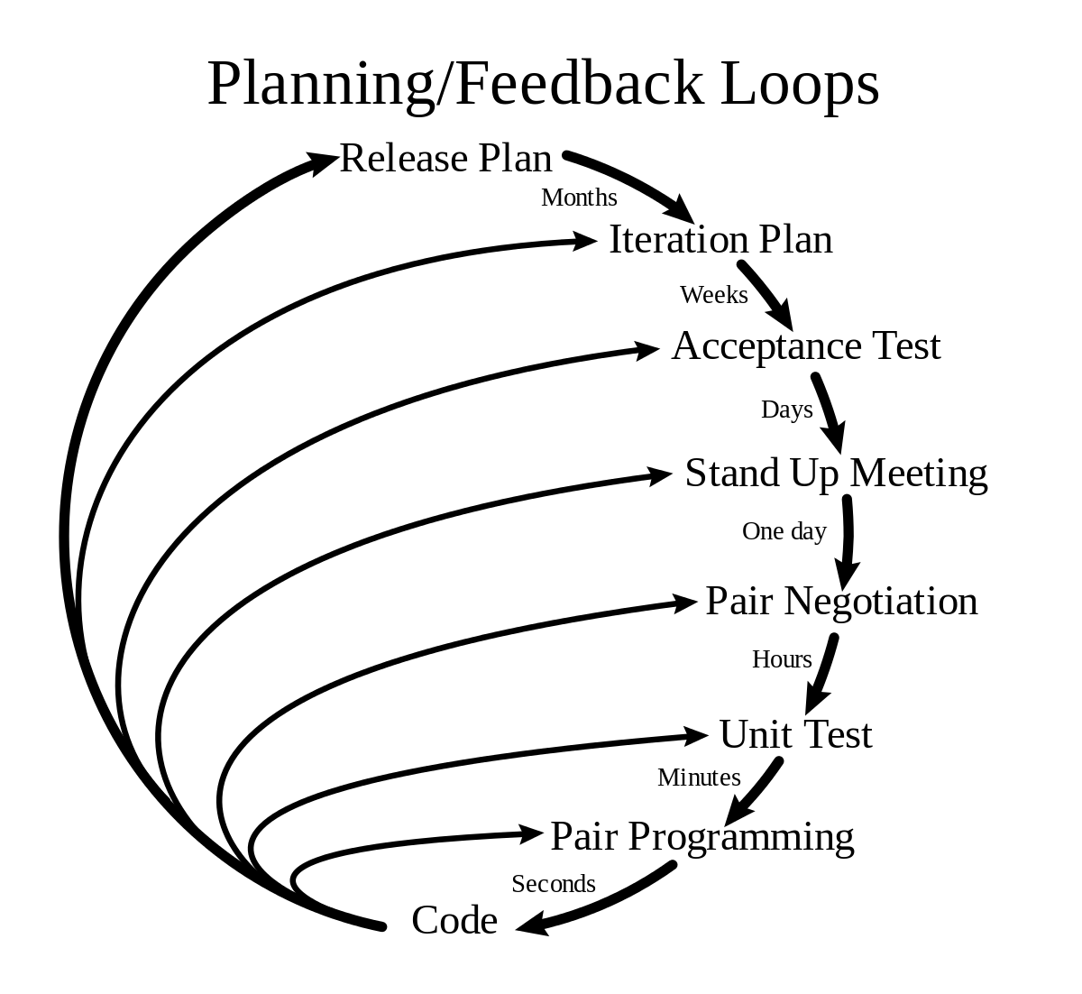

Slide 25
The five values of XP
Communication
Simplicity
Feedback
Courage
Respect

Slide 26
12 rules
User stories (planning): The customer defines the desired features for the new application and describes each feature's business value and priority. The project team will employ the user stories for cost estimating and project management.
Small releases (building blocks): With XP, you develop and deliver the application in a series of small, frequently updated versions. As each new requirement is added, complete the system and re-release.
Metaphor (standardized naming schemes): XP systems development requires adhering to a set of standards for items such as variable names, class names, and methods.
Collective ownership: No one person owns or is responsible for individual code segments.
Coding standard: All team members write code in the same way, using the same styles and formats. This allows for rapid code sharing and reduces the learning curve for other developers.

Slide 27
Simple design: The best design is the easiest one that works.
Refactoring: Each member should have a synchronous understanding of the application and should continually work to adjust and improve the code.
Testing: Each building block (small release) must be thoroughly tested prior to release .
Pair programming: All code is developed by two programmers who work together at a single machine.
Continuous integration: Software builds are completed several times a day. This keeps all developers on the same page by keeping the application up to date with the most recent coding changes.
40-hour workweek
On-site customer

Slide 28
pros
Reduces costs
Teamwork
Fast
Visible

Slide 29
CONS
Code overcomes design
Location
Lack of documentation
Stress

